Slide 1

R Wizardry, week 1 (continuation):
Data Types
January 18th, 2017

Slide 2
R data Types
R has a wide variety of data types including:
Scalars (a single number)
Vectors (numerical, character, logical)
Matrices
Arrays
Data frames
Lists
S4
From “R in Action” by Robert I. Kabacoff

Slide 3
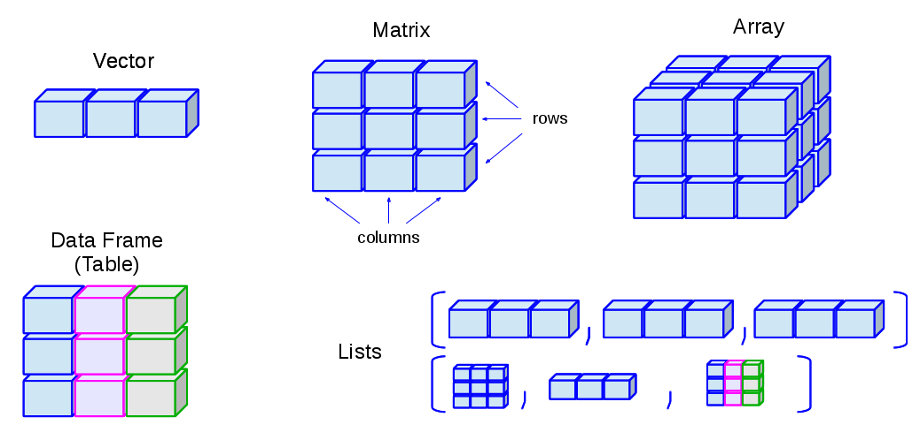
Scalars and Vectors
Scalar:
X <- 5 ; b <- 10
Vectors (numerical, character, logical):
a <- c(1,2,5.3,6,-2,4) # numeric vector
b <- c("one","two","three") # character vector
c <- c(TRUE,TRUE,TRUE,FALSE,TRUE,FALSE) #logical vector

Slide 4
Matrices
All columns in a matrix must have the same mode (numeric, character, etc.) and the same length.
#Generates 5 x 4 numeric matrix :
y <- matrix(1:20, nrow = 5, ncol = 4)
# Another example
cells <- c(1, 26, 24, 68)
rnames <- c("R1", "R2")
cnames <- c("C1", "C2")
mymatrix <- matrix(cells, nrow = 2, ncol = 2, byrow = T, dimnames=list(rnames, cnames))

Slide 5
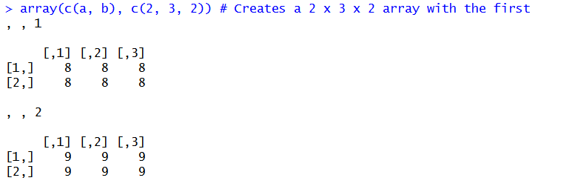
Arrays
An n-dimensional array is a set of stacked matrices of identical dimensions
a <- matrix(8, 2, 3) # Creates a 2 x 3 matrix populated with 8's.
b <- matrix(9, 2, 3) # Creates a 2 x 3 matrix populated with 9's.
http://r.iq.harvard.edu/docs/zelig/3.4-8/Ways_to_create.html

Slide 6
Data Frames
A data frame is more general than a matrix, in that different columns can have different modes (numeric, character, factor, etc.).
d <- c(1,2,3,4)
e <- c("red", "white", "red", NA)
f <- c(TRUE,TRUE,TRUE,FALSE)
mydata <- data.frame(d,e,f)
>
d e f
1 red TRUE
2 white TRUE
3 red TRUE
4 <NA> FALSE

Slide 7
Lists
An ordered collection of objects (components). A list allows you to gather a variety of (possibly unrelated) objects under one name.
Example of a list with 4 components -a string, a numeric vector, a matrix, and a scalar:
w <- list(name = "Fred", mynumbers = a, mymatrix = y, age = 5.3)
Example of a list containing two lists
v <- c(list1, list2)

Slide 8
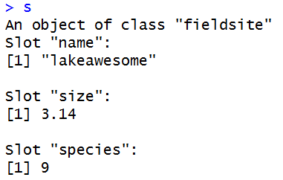
S4 Objects
Similar to a vector, except it has slots that can have different types of variables (character, numeric, etc.)
Little more work to set up than other data types.
Example:
setClass("fieldsite", slots=list(name="character", size="numeric", species="integer"))
s <- new("fieldsite", name="lakeawesome", size=3.14, species=9L)
Notes:
Conceptually, factors are variables in R which take on a limited number of different values; such variables are often referred to as categorical variables. One of the most important uses of factors is in statistical modeling; since categorical variables enter into statistical models differently than continuous variables, storing data as factors insures that the modeling functions will treat such data correctly.

Slide 9
For more information and replicable examples go to:
http://www.statmethods.net/input/datatypes.html
“R in Action” by Robert I. Kabacoff

